Slide 1
Assistive Technology & Universal Design
What Every Online Instructor Needs to Know…

Slide 2
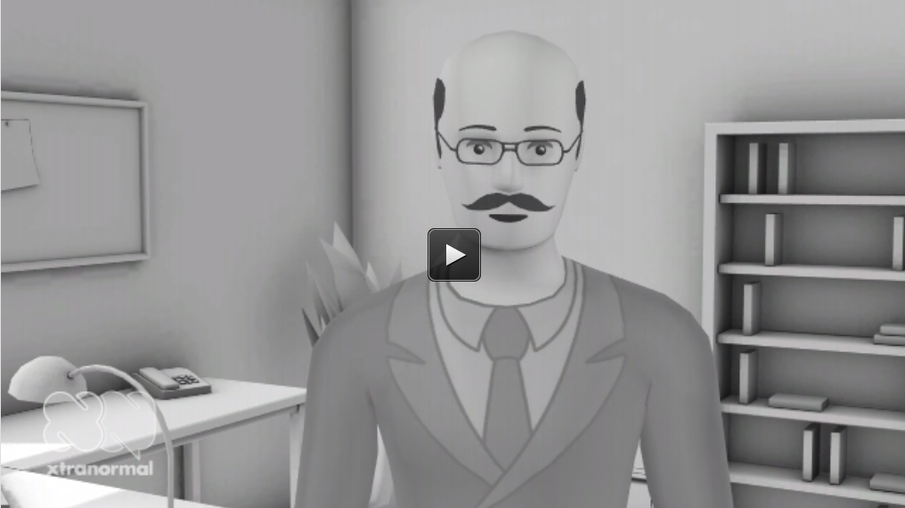
UDL Explained
See video at http://www.xtranormal.com/watch/13591289/universal-design-explained

Slide 3
Accessibility and Online Learning
Robert Beach

Slide 4
Accessibility: Whose Responsibility?
Two accessibility components: the LMS & the course content.
LMS accessibility: institutional responsibility.
Course content accessibility: faculty responsibility.
Make course materials/content accessible from the start, not as a refit.
Physical accessibility has become more common place, time now for electronic accessibility.
Notes:
1) There are two components to the accessibility of online education, the LMS and the course content. 2) The accessibility of the LMS is the responsibility of the institution via the online education department. 3) The accessibility of the course content is the responsibility of the institution via the faculty. 4) Faculty need to understand how to make course materials/content accessible from the start, not as a refit. 5) Just as physical accessibility of the institution has become more common place, it is time that electronic accessibility also become commonly considered at all stages.

Slide 5
Accessibility and Online Learning
Susan Stuart

Slide 6
Issues
Institutional buy-in and policymaking
Instructor resistance and access
Student awareness and access
Technical Support
Academic Support
Purchasing

Slide 7
Institutional Change
Realize that there are at a minimum 5 legal mandates to providing accessible online learning!
Recognize the value of digital media which offers flexibility
Definitions, hints, how to guides can be built in
Scaffolding can be embedded to support learners
Engagement and interactivity provides choice
Top down change strategies are necessary to define mission
Recognize that this requires change and change is HARD!!!!
Plan for training and support change
Notes:
New Directions in Higher Education: Disability Services and Campus Dynamics, Harbour, Wendy, S. and Joseph Madausm, ED. Summer 2011 Number 154. Jossey-Bass, San Francisco.

Slide 8
What Administrators Can Do
Challenge early adopters to advance technology initiatives to explicitly include diverse learners
Encourage initiatives on the learning side of teaching
Recognize that not all technology purchases are equal
Encourage faculty to provide readings in multiple formats
Become part of teams making software decisions
Notes:
White boards do nothing to promote diversity
From US. Department of Education OCR, 2003:
When printed material is provided, the college is obligated to obtain an alternative version
Accessible online course content must be provided in a timely manner. Post content in an accessible format rather than retrofitting it later.
“When a public institution selects software programs and/or hardware that are not adaptable fore access by the person with disabilities, the subsequent substantial expense of providing access is not generally regarded as an undue burden when such cost could have been significantly reduced by considering the issues of accessibility at the time of the initial selection”

Slide 9
Leadership and Planning
Realize that bottom up change strategies are also necessary
Devote resources to technology that supports the diverse learner inside and outside the classroom.
Consider course improvement mini-grants and incentives
Have instructors collect evidence about how instructional innovation affects student learning and share with colleagues

Slide 10
Support Services
Needs to be institution wide
Needs to have a clear mission
Needs policies that guide the mission
Defining roles and responsibilities
Academic support and technical support
Develop awareness and skill training (ongoing)

Slide 11
About the LMS
Report from the American Foundation for the Blind 2008, lists three components to online learning:
Accessibility of the learning management system
Accessibility of the actual content
The skill of the student in using up-to-date technology
Notes:
The LMS needs to be a gateway into courses that can be easily navigated
Faculty needs to provide content that meets high standards of effective communication and avoids accessibility problems
Students need to come to the LMS experience prepared to be a responsible learner, including being equipped with a quality computer and adaptive technology to facilitate the process.

Slide 12
Good Resources
Coombs, N. (2010). Making online teaching accessible: Inclusive courses design for students with disabilities. Jossey Bass.
Harbour, W.S. and Madausm, J., (Ed). (2011). New directions in higher education: Disability services and campus dynamics. Jossey-Bass.
Bugstahler, S.E. and Cory, R.C. Cory, (Ed.). (2010). Universal design in higher education: From practice to principle. Harvard Educational Press.

Slide 13
Accessibility: Tools of the Trade
Tim Sears

Slide 14
Working with What You Have
Windows Accessibility Features
Mac Accessibility Features

Slide 15
Vision Products
Low Vision Magnifiers
Zoom Text www.aisquared.com
Magic www.freedomscientific.com
CCTVs

Slide 16
Blindness Products
Screen Readers
Jaws www.freedomscientific.com
Window Eyes www.freedomscientific.com
Braille Embossers CCTVs

Slide 17
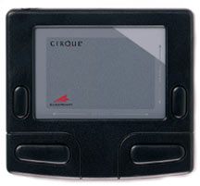
Mobility Products
Alternatives to the Traditional
Mouse and Keyboard
Voice to Text
Dragon Naturally Speaking

Slide 18
Literacy Products
Reading and Writing Programs
Wynn www.freedomscientific.com
Read and Write http://www.texthelp.com
Others: Don Johnston and Kurzweil

Slide 19
Website Links
Microsoft Accessibility www.microsoft.com/enable/
Mac Accessibility http://www.apple.com/accessibility/
Nanopac www.nanopac.com
Enable Mart www.enablemart.com
Maxi Aids www.maxiaids.com/
Freedom Scientific www.freedomscientific.com/
Window Eyes http://www.gwmicro.com/
Zoom Text www.aisquared.com
Dragon www.nuance.com
Read & Write www.texthelp.com

Slide 20
Accessibility: Proactive Steps
Janna Willnauer

Slide 21
Interpreted Video
Notes:
The one thing we are doing is using files the instructor has made on Camtasia……we are typing the script and adding it for captioning and we are also making a video of an interpreter to add both of these options to the Angel class. It is a hybrid class, we know there is a deaf student in it.

Slide 22
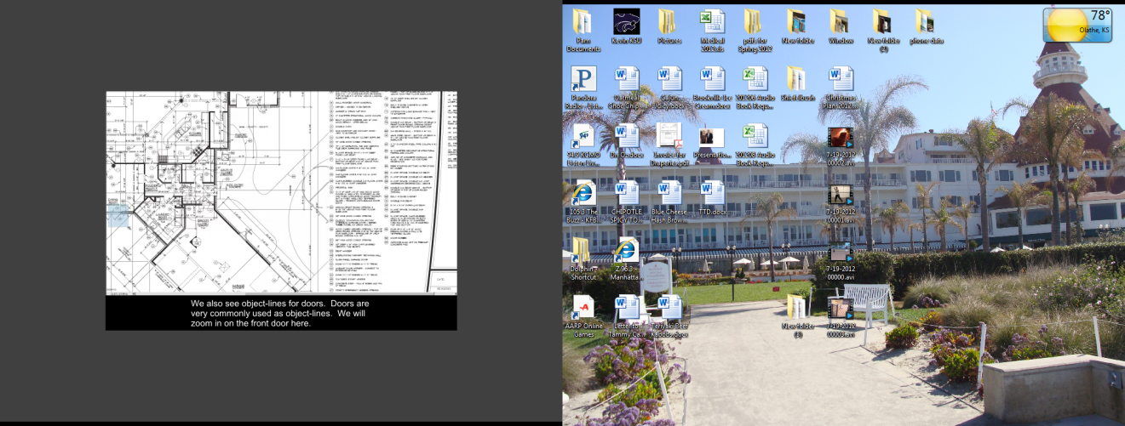
Captioned Video
Notes:
Class/professor requests captioning/interpreting of videos for ANGEL (campus LMS)
Professor sends MP4/FLV or other video file containing both audio and video
Create (Word) script from audio
Access Services does their own transcription (via a contracted service) but the ETC can also do this by request through campus Desktop Publishing
Import script into Camtasia Studio and sync with video to create captions.
Video tape interpreter
Import interpreter’s video and sync with same video in Camtasia Studio
Finished product: two files produced through Camtasia Studio, one with captioning only and one with interpreter (picture in a picture)
Professor uploads final product into ANGEL LMS
The college prefers not to upload video files into ANGEL directly, because it makes the courses too big for easy backups and copies.
The ETC provides instructions to instructors for putting video files on the streaming server, and embedding them in ANGEL.
(JCCC) Our ADA committee has a technology group. We have decided to focus our efforts on getting staff to work on the captioning of materials on campus. (classroom, Angel, etc.) Captioning is good for the 25 deaf students but also for those with a hearing loss and ESL students.

